Slide 1
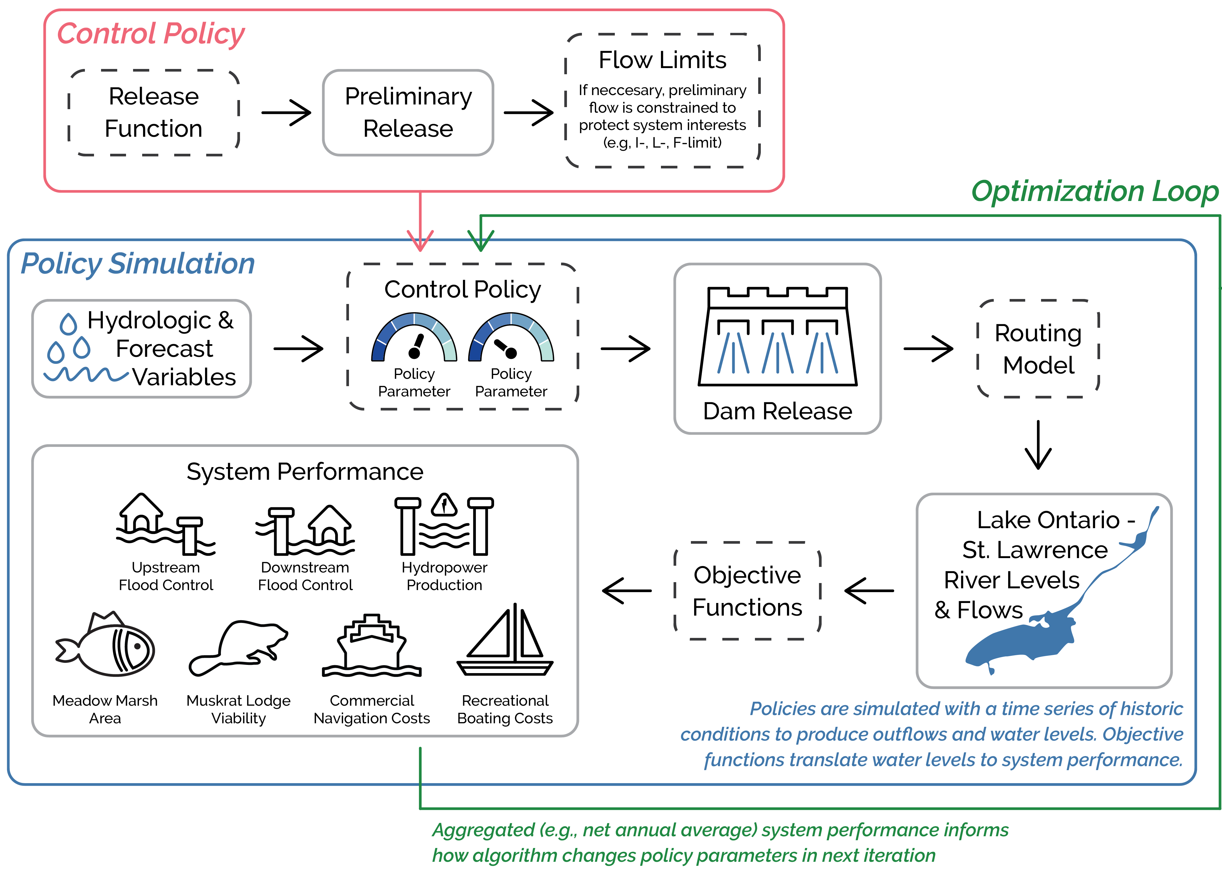
3 major components:
Simulating a control policy
Evaluating a control policy’s performance
Optimizing control policy parameters

Slide 2
Simulating a control policy
What is a control policy?
A release function calculates a preliminary outflow
Flow limit function adjusts the preliminary outflow (if necessary) and returns the final outflow
Final outflow is routed through the system

Slide 3
Evaluating a control policy’s performance
Control policy returns a time series of quarter-monthly water levels and flows
Performance indicator models translate levels and flows into a time series of system impacts

Slide 4
Optimizing control policy parameters
The time series of system impacts is aggregated to the optimization algorithm
For upstream flooding, the total number of homes flooded in each year is summed, then the average across all years is returned (i.e. net annual average)

Slide 5
Optimizing control policy parameters
Optimization algorithm sees 1 value for each objective
Algorithm uses performance to inform how it changes the dials in the next iteration or function evaluation

Slide 6
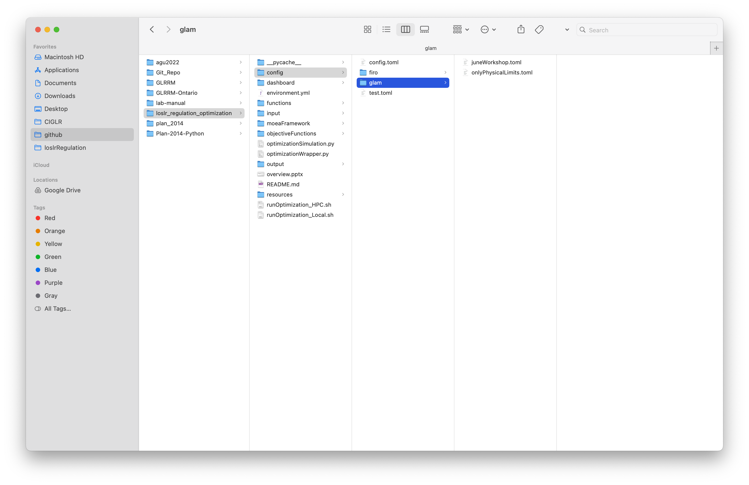
Running an experiment:
Configuration files setup the experiment and are written in TOML
Specify the release function, flow limit function, routing scheme, and objective functions
Setup the optimization parameters (e.g. number of function evaluations)

Slide 7
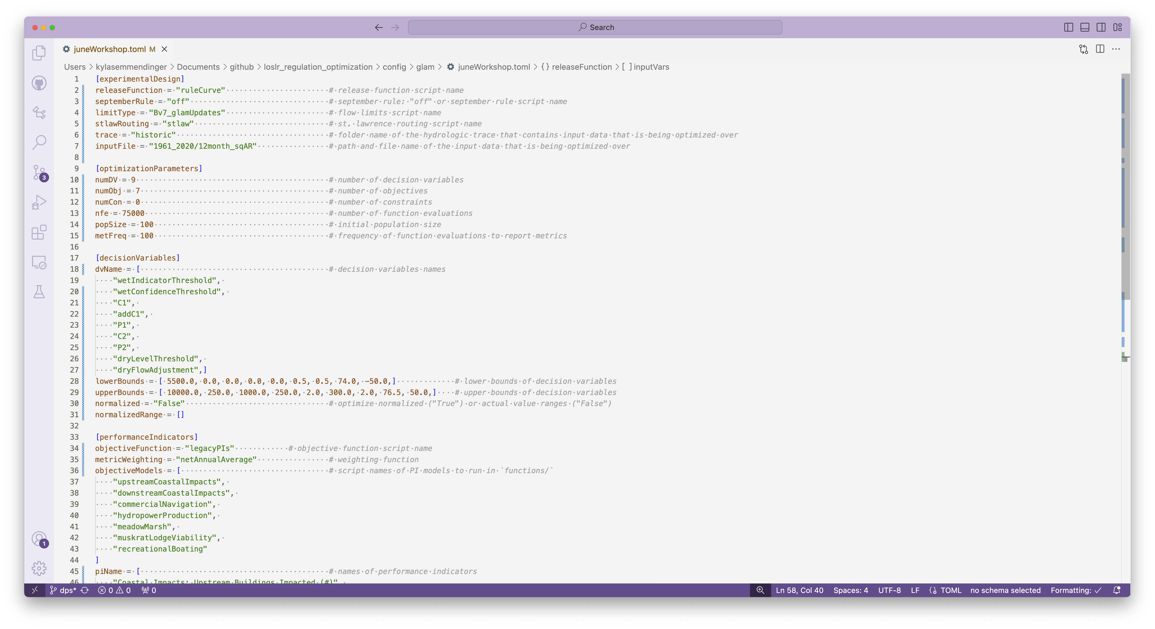


Slide 8
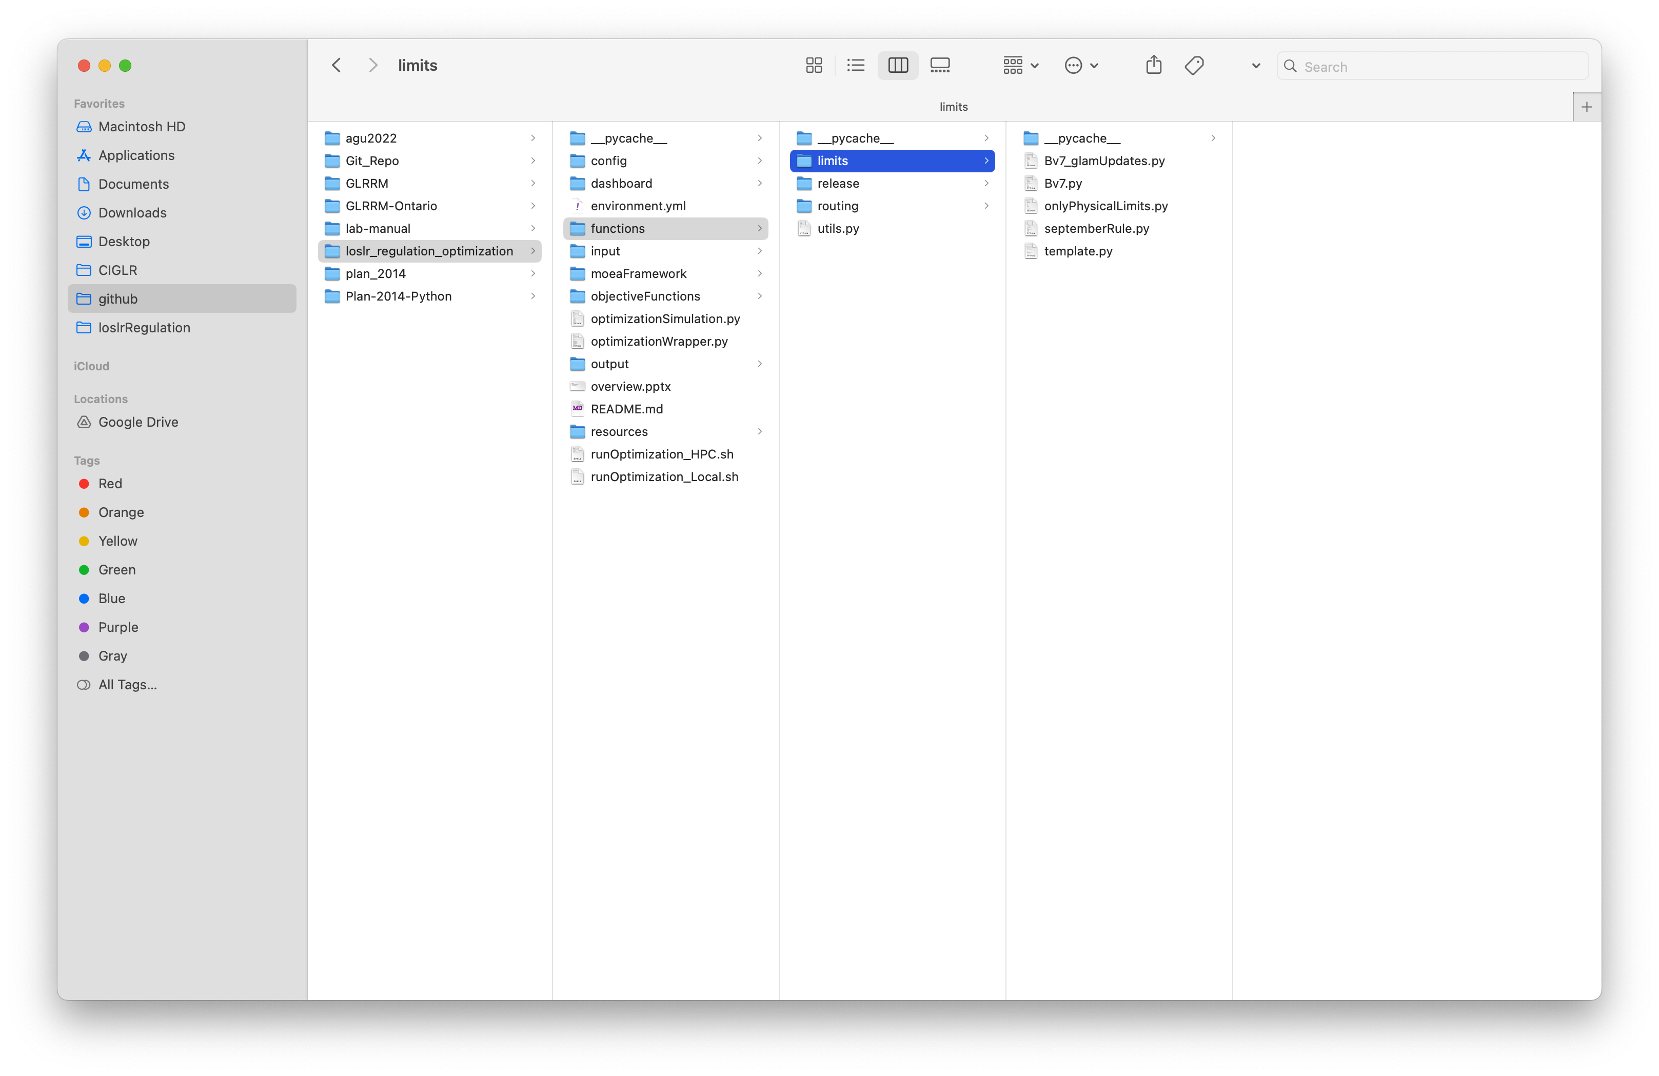

Slide 9
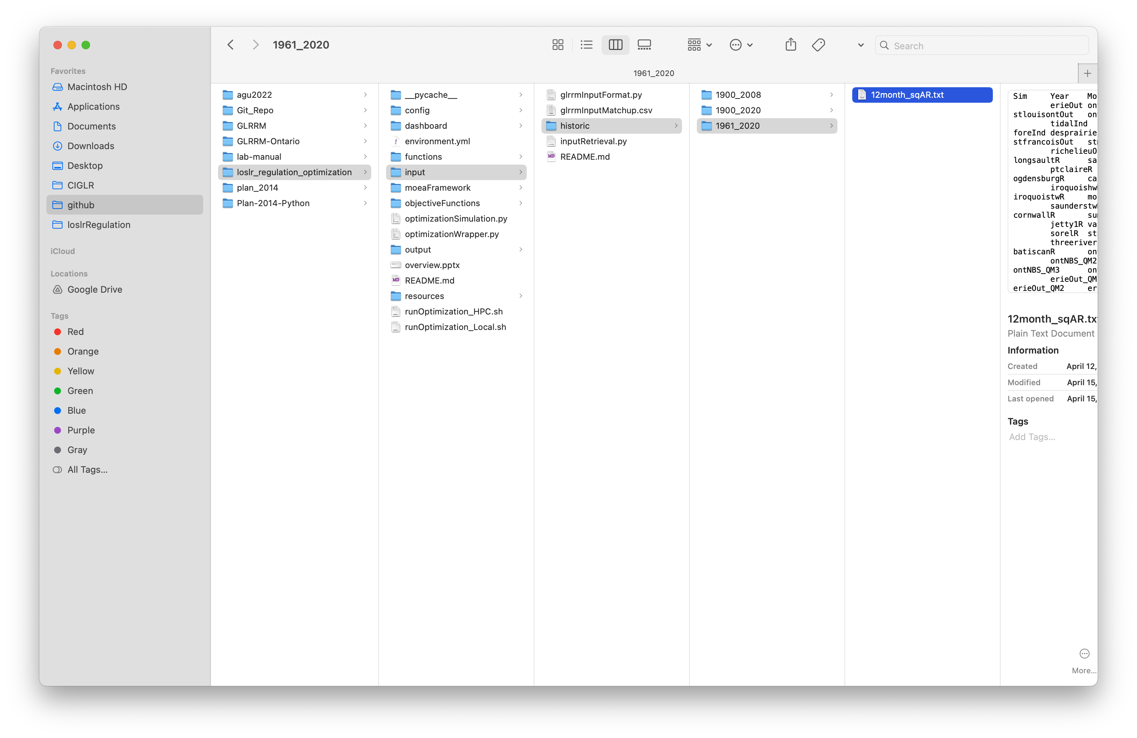

Slide 12
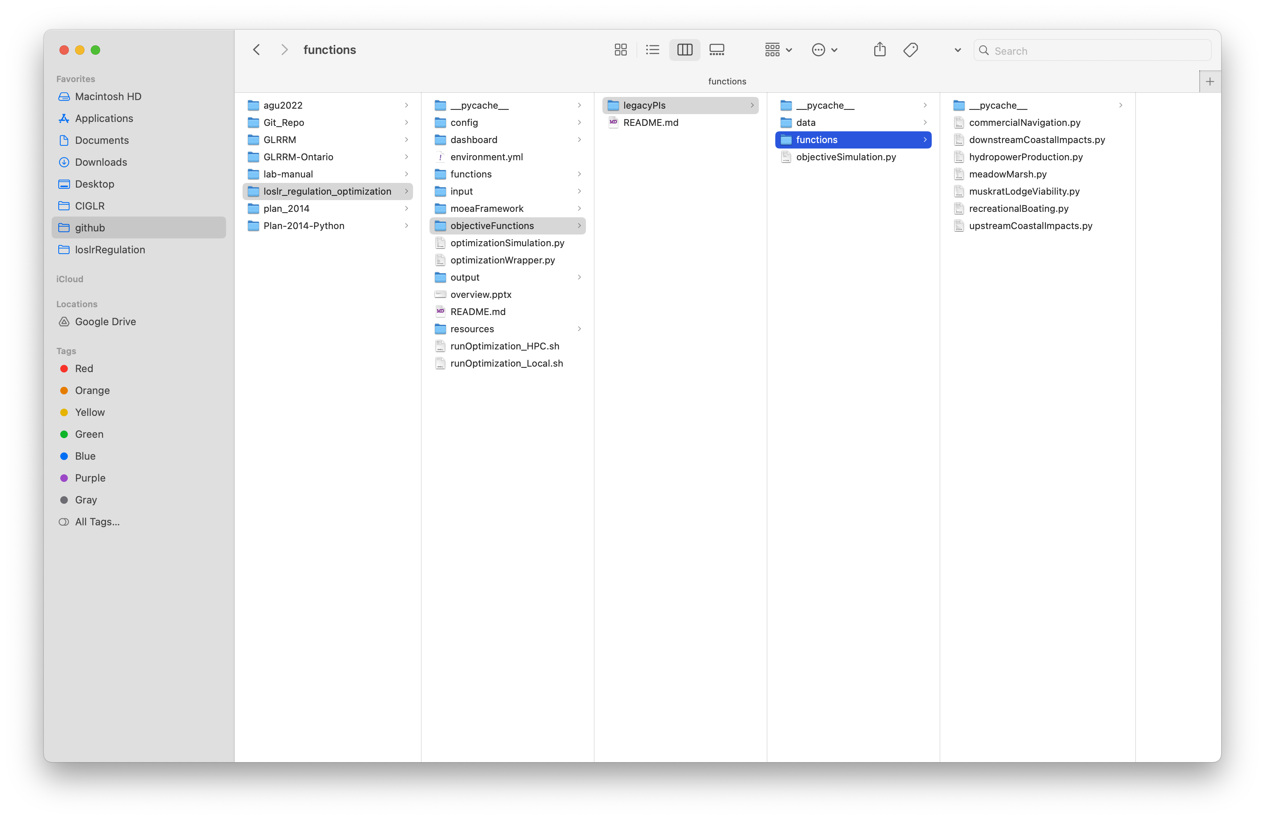

Slide 13
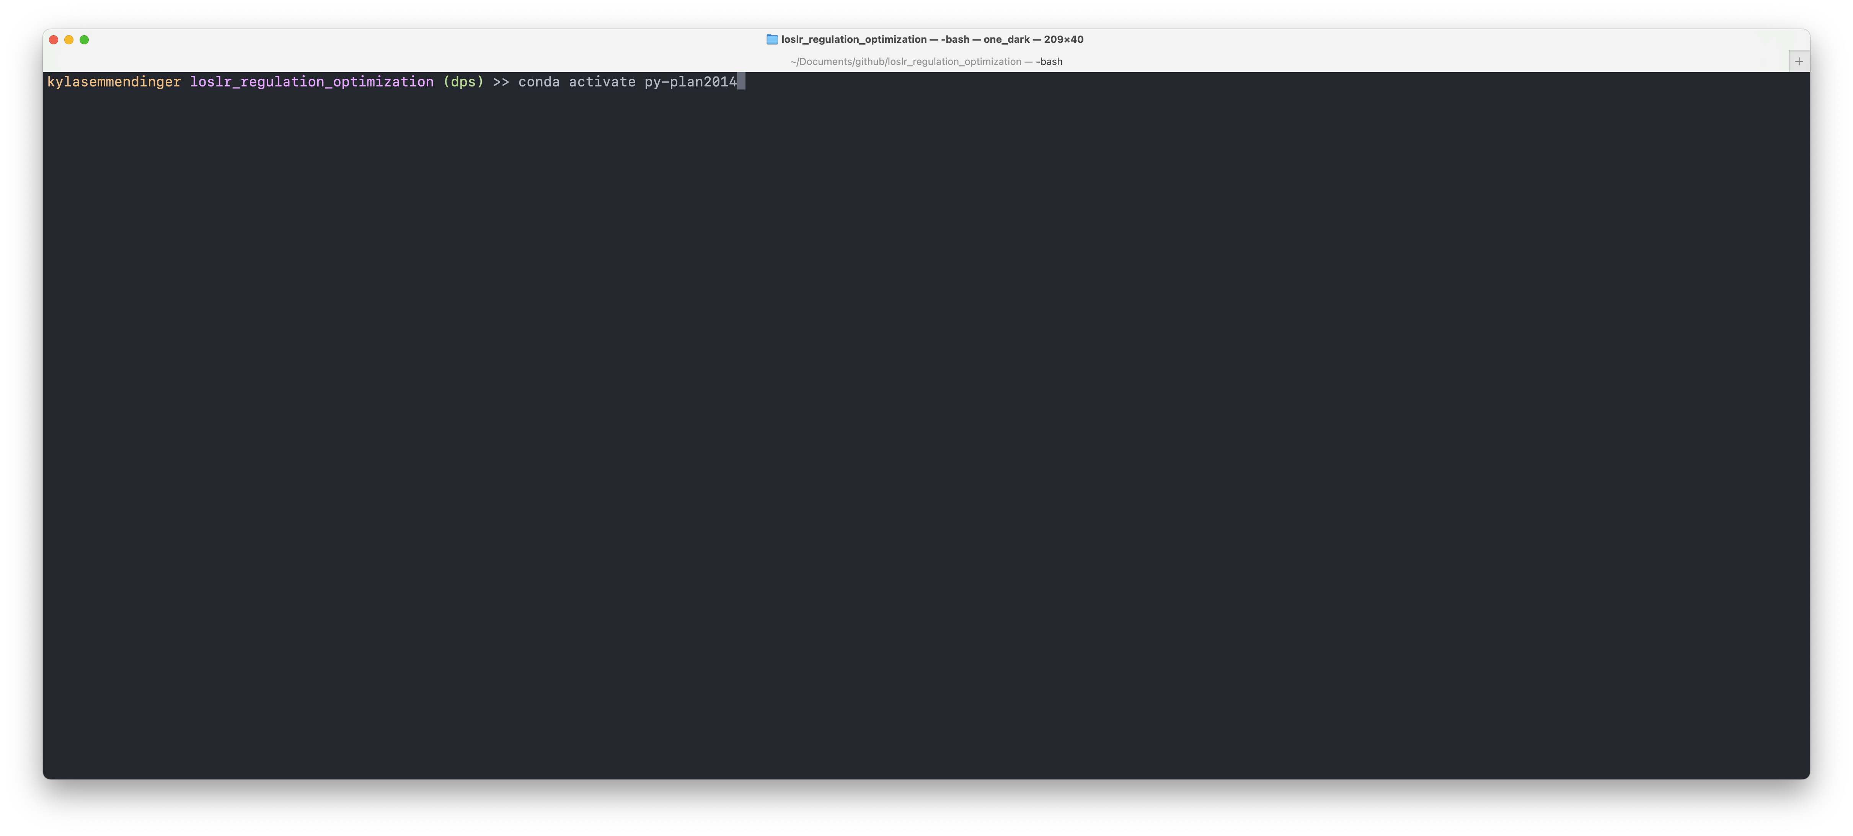
Running the optimization

Slide 14
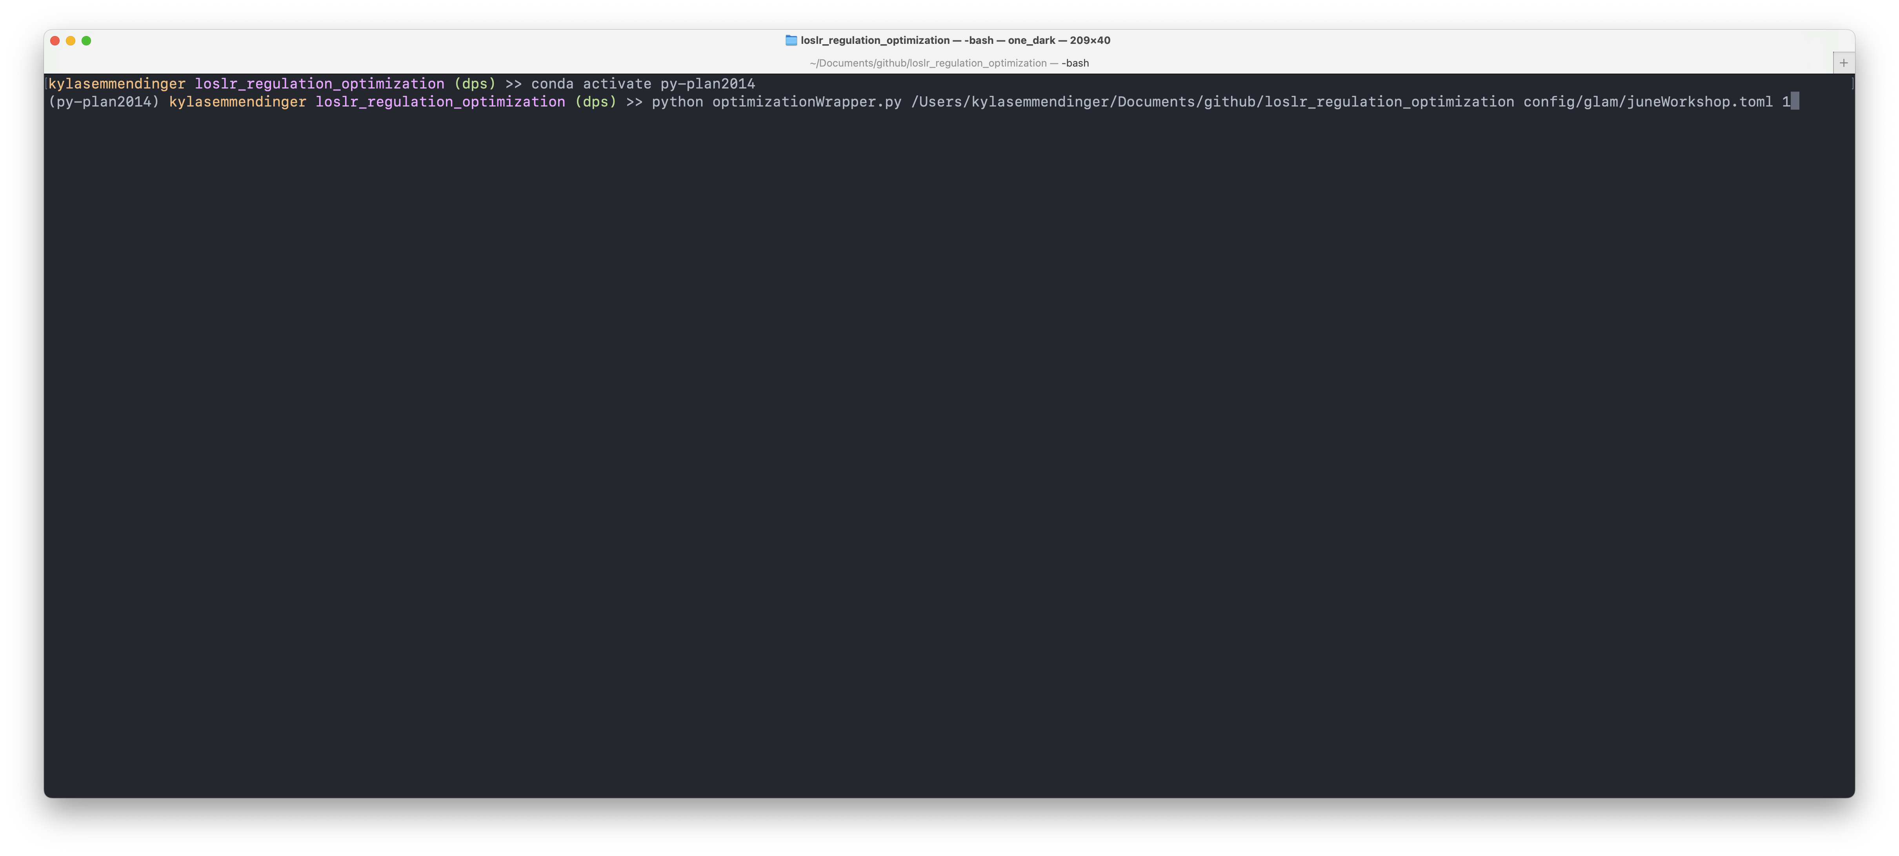
Running the optimization

Slide 15
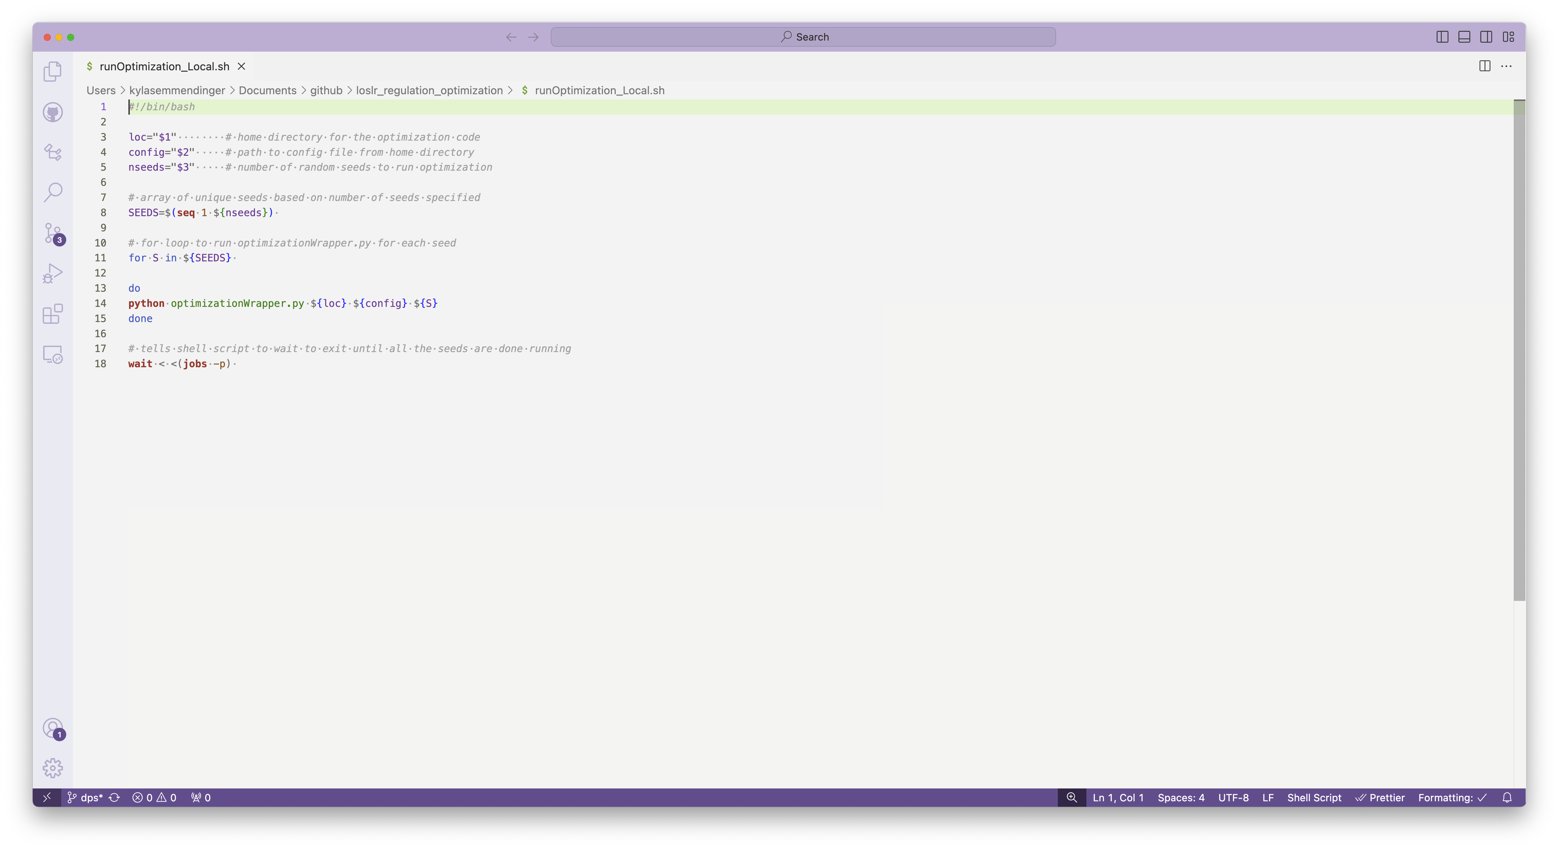
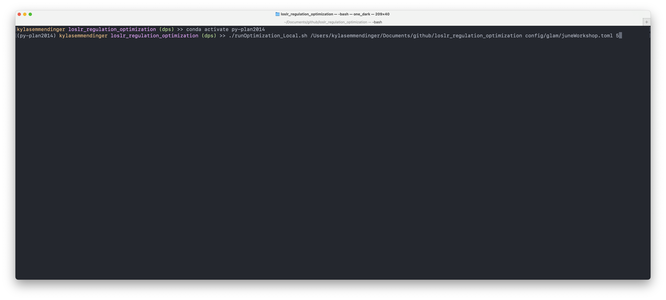

Slide 16
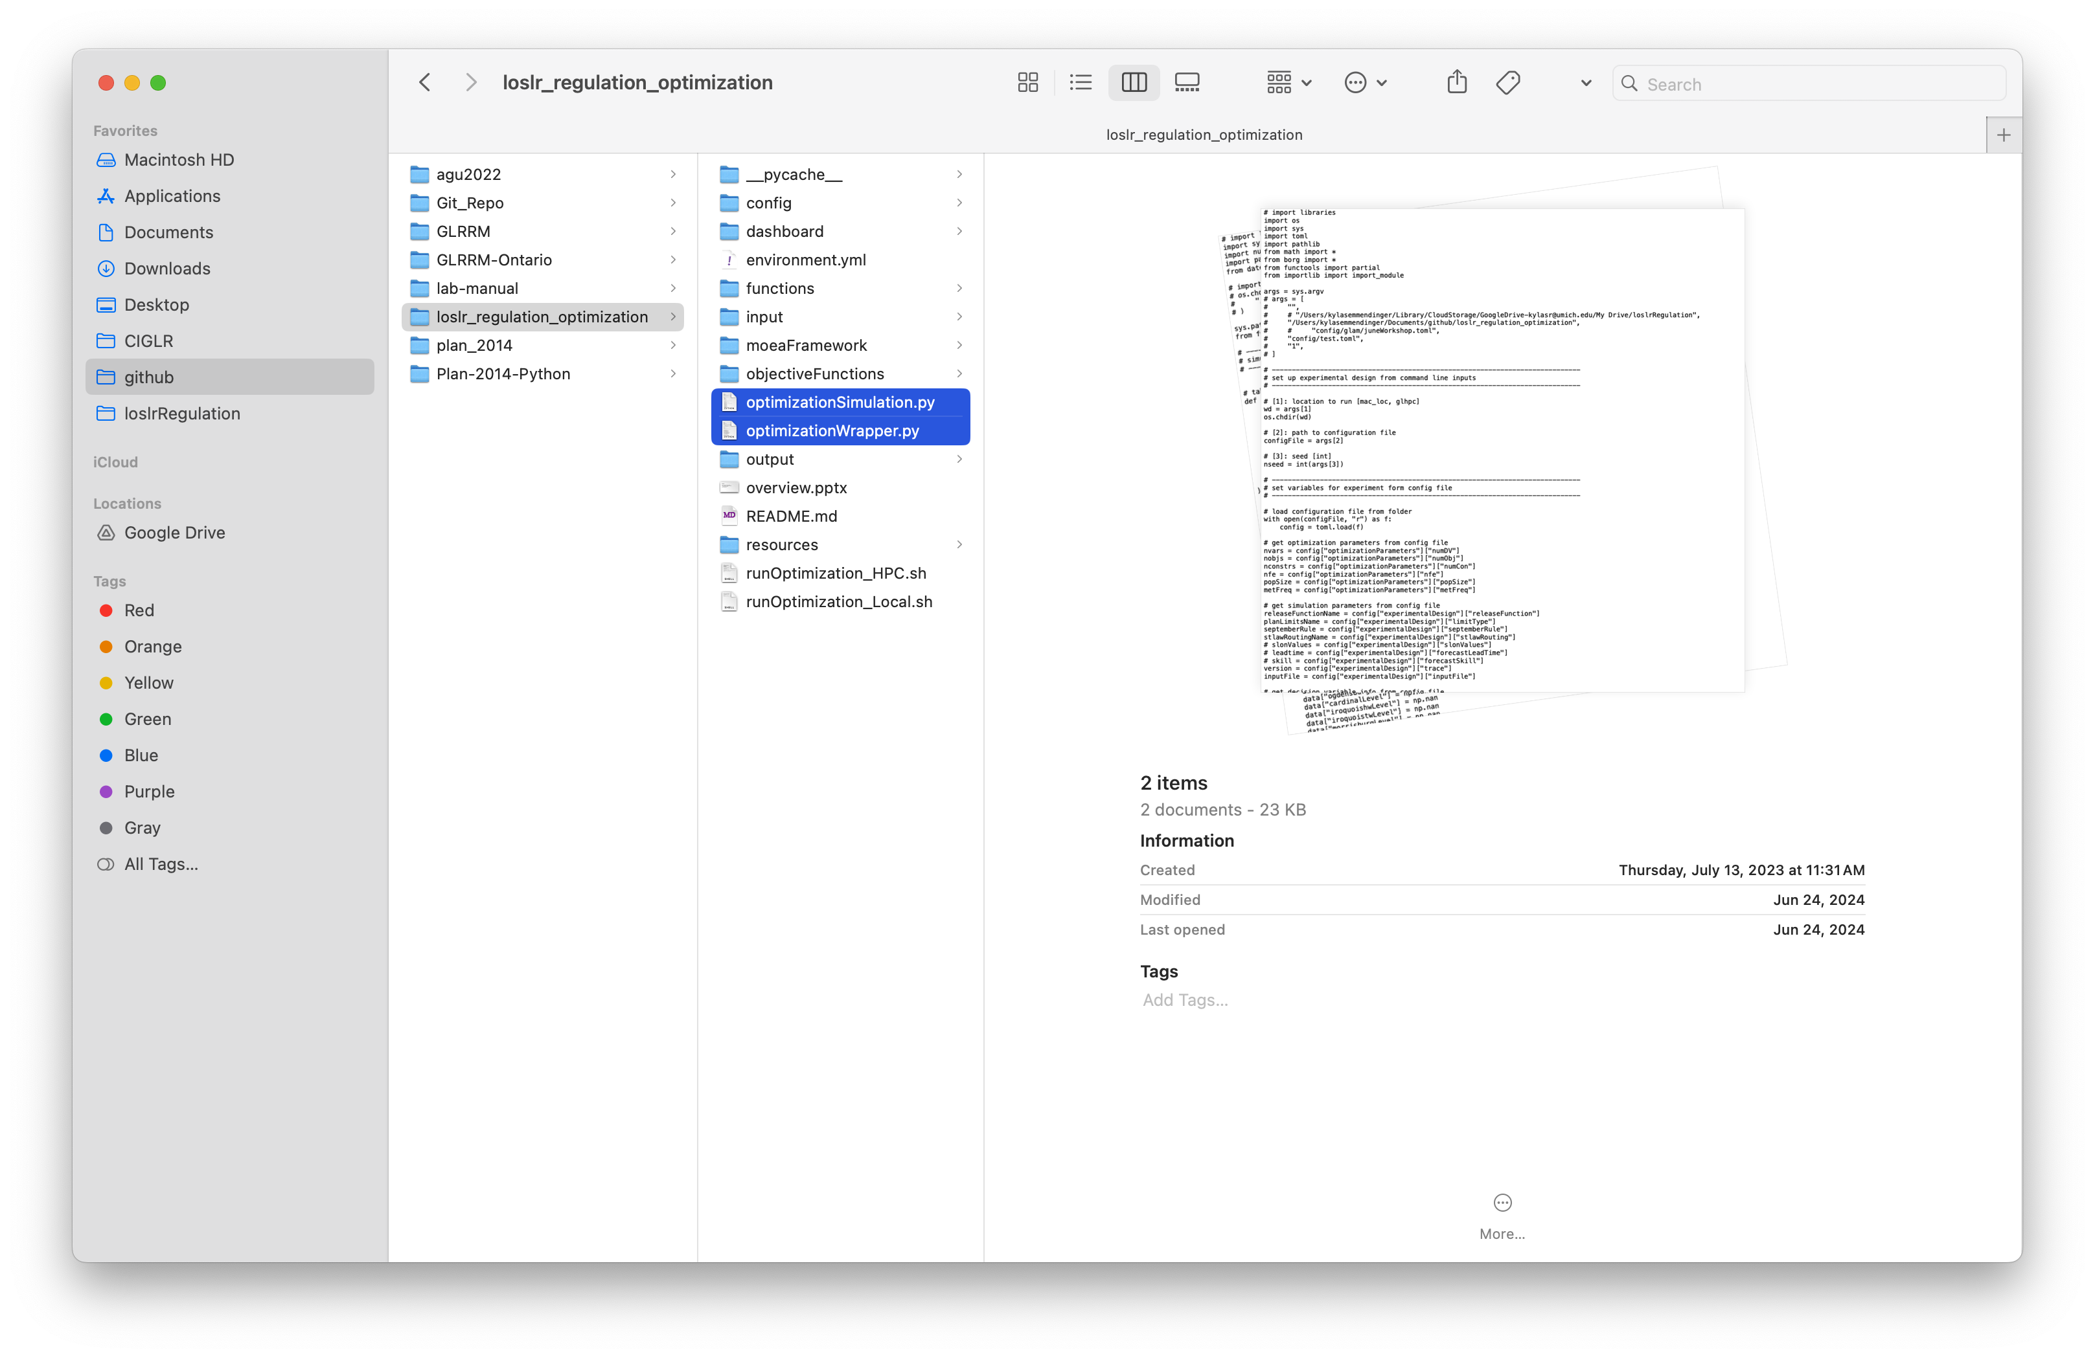
Main scripts
`optimizationWrapper` sets up the experiment in Borg and calls `optimizationSimulation`
Green optimization loop
`optimizationSimulation` simulates the time series of water levels and system impacts and returns aggregated metrics to Borg
Blue simulation loop
Modules are defined in the `functions/` directory
Pink control policy loop (and routing)

Slide 17
Other things to note:
Syntax might look funky… code has been optimized for speed!
Have not tested on Windows
Pathing might be an issue, just be aware!
Templates are included to help you write new functions
Required outputs are described in each function
Setting up the many-objective evolutionary algorithm, Borg
Documentation is linked in the repo
Compiling the MOEAFramework (to calculate Borg metrics)
Documentation is linked in the repo

